Slide 1
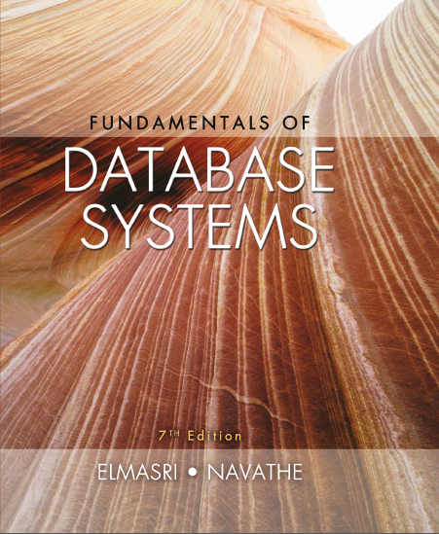
Fundamentals of Database Systems
Seventh Edition
Chapter 10
Introduction to S Q L Programming Techniques
Copyright © 2016, 2011, 2007 Pearson Education, Inc. All Rights Reserved
Notes:
If this PowerPoint presentation contains mathematical equations, you may need to check that your computer has the following installed:
1) MathType Plugin
2) Math Player (free versions available)
3) NVDA Reader (free versions available)

Slide 2
Learning Objectives
10.1 Database Programming: Techniques and Issues
10.2 Embedded S Q L, Dynamic S Q L, and S Q L J
10.3 Database Programming with Function Calls: S Q L / C L I and J D B C
10.4 Database Stored Procedures and S Q L / P S M
10.5 Comparing the Three Approaches

Slide 3
Introduction to S Q L Programming Techniques
Database applications
Host language
Java, C/C++/C#, COBOL, or some other programming language
Data sublanguage
S Q L
S Q L standards
Continually evolving
Each D B M S vendor may have some variations from standard

Slide 4

Database Programming: Techniques and Issues
Interactive interface
S Q L commands typed directly into a monitor
Execute file of commands
Application programs or database applications
Used as canned transactions by the end users access a database
May have Web interface

Slide 5
Approaches to Database Programming (1 of 2)
Embedding database commands in a general-purpose programming language
Database statements identified by a special prefix
Precompiler or preprocessor scans the source program code
Identify database statements and extract them for processing by the D B M S
Called embedded S Q L

Slide 6
Approaches to Database Programming (2 of 2)
Using a library of database functions
Library of functions available to the host programming language
Application programming interface (A P I)
Designing a brand-new language
Database programming language designed from scratch
First two approaches are more common

Slide 7
Impedance Mismatch
Differences between database model and programming language model
Binding for each host programming language
Specifies for each attribute type the compatible programming language types
Cursor or iterator variable
Loop over the tuples in a query result

Slide 8
Typical Sequence of Interaction in Database Programming
Open a connection to database server
Interact with database by submitting queries, updates, and other database commands
Terminate or close connection to database

Slide 9
Embedded S Q L, Dynamic S Q L, and S Q L J
Embedded S Q L
C language
S Q L J
Java language
Programming language called host language

Slide 10
Retrieving Single Tuples with Embedded S Q L (1 of 4)
E X E C S Q L
Prefix
Preprocessor separates embedded S Q L statements from host language code
Terminated by a matching END-E X E C
Or by a semicolon (;)
Shared variables
Used in both the C program and the embedded S Q L statements
Prefixed by a colon (:) in S Q L statement

Slide 11
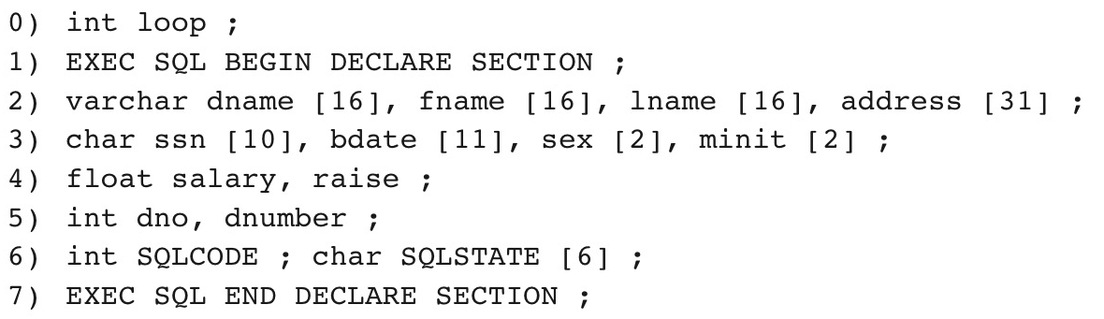
Figure 10.1 C Program Variables Used in the Embedded S Q L Examples E1 and E2

Slide 12
Retrieving Single Tuples with Embedded S Q L (2 of 4)
Connecting to the database
Change connection
Terminate connection

Slide 13
Retrieving Single Tuples with Embedded S Q L (3 of 4)
S Q LCODE and S Q LSTATE communication variables
Used by D B M S to communicate exception or error conditions
S Q LCODE variable
0 = statement executed successfully
100 = no more data available in query result
< 0 = indicates some error has occurred

Slide 14
Retrieving Single Tuples with Embedded S Q L (4 of 4)
S Q LSTATE
String of five characters
‘00000’ = no error or exception
Other values indicate various errors or exceptions
For example, ‘02000’ indicates ‘no more data’ when using S Q LSTATE

Slide 15
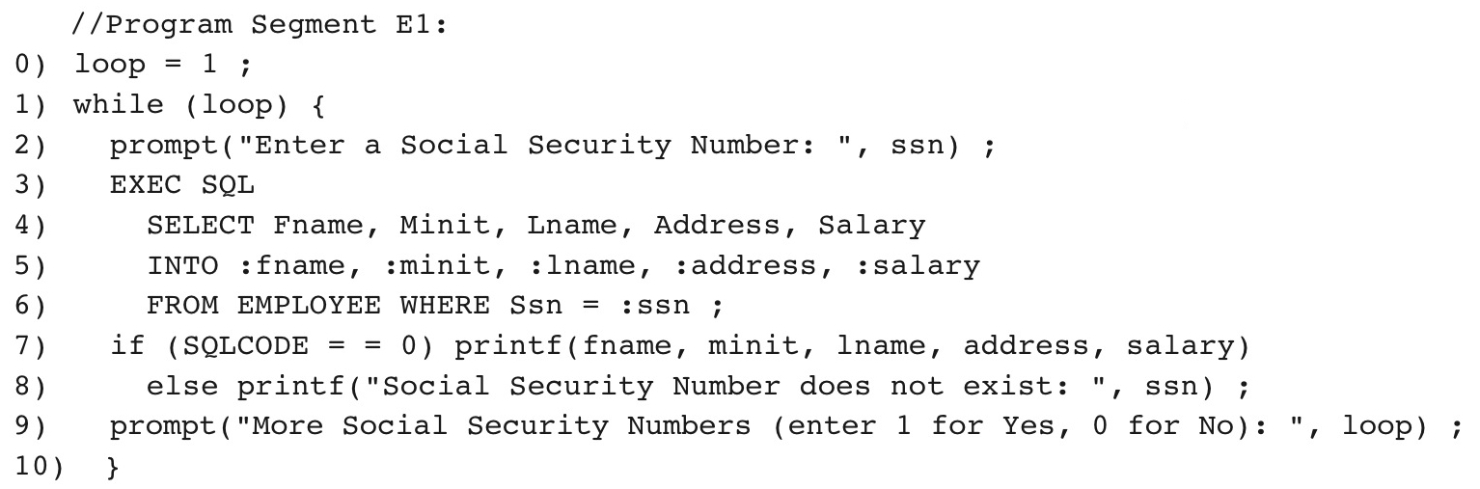
Figure 10.2 Program Segment E1, a C Program Segment with Embedded S Q L

Slide 16
Retrieving Multiple Tuples with Embedded S Q L Using Cursors (1 of 2)
Cursor
Points to a single tuple (row) from result of query
OPEN CURSOR command
Fetches query result and sets cursor to a position before first row in result
Becomes current row for cursor
FETCH commands
Moves cursor to next row in result of query

Slide 17
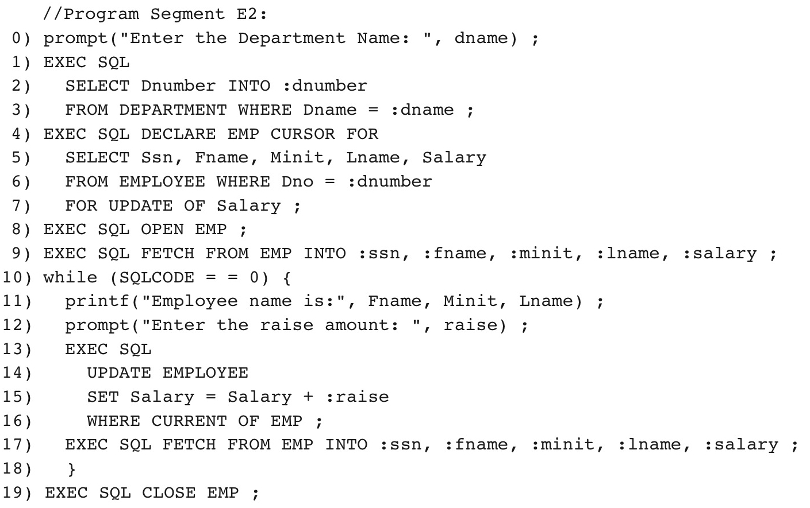
Figure 10.3 Program Segment E2, a C Program Segment That Uses Cursors with Embedded S Q L for Update Purposes

Slide 18
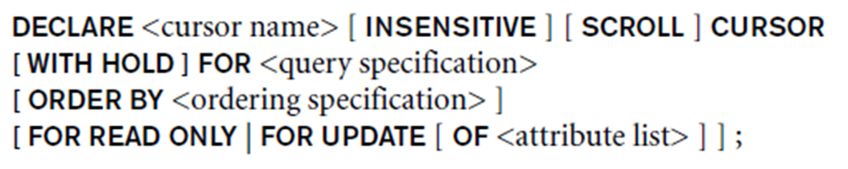
Retrieving Multiple Tuples with Embedded S Q L Using Cursors (2 of 2)
FOR UPDATE OF
List the names of any attributes that will be updated by the program
Fetch orientation
Added using value: NEXT, PRIOR, FIRST, LAST, ABSOLUTE i, and RELATIVE i

Slide 19
Specifying Queries at Runtime Using Dynamic S Q L
Dynamic S Q L
Execute different S Q L queries or updates dynamically at runtime
Dynamic update
Dynamic query

Slide 20
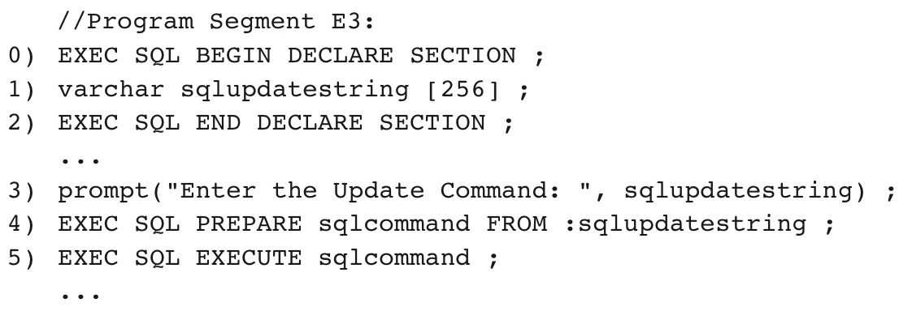
Figure 10.4 Program Segment E3, a C Program Segment That Uses Dynamic S Q L for Updating a Table

Slide 21
S Q L J: Embedding S Q L Commands in Java
Standard adopted by several vendors for embedding S Q L in Java
Import several class libraries
Default context
Uses exceptions for error handling
S Q L Exception is used to return errors or exception conditions

Slide 22
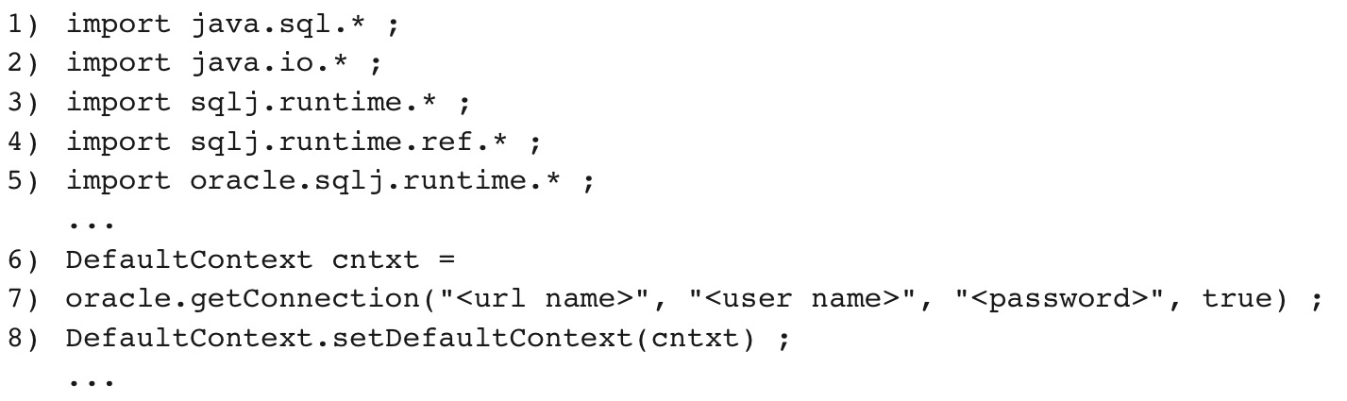
Figure 10.5 Importing Classes Needed for Including S Q L J in Java Programs in Oracle, and Establishing a Connection and Default Context

Slide 23
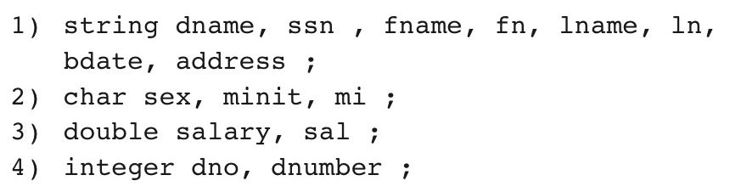
Figure 10.6 Java Program Variables Used in S Q L J Examples J1 and J2

Slide 24
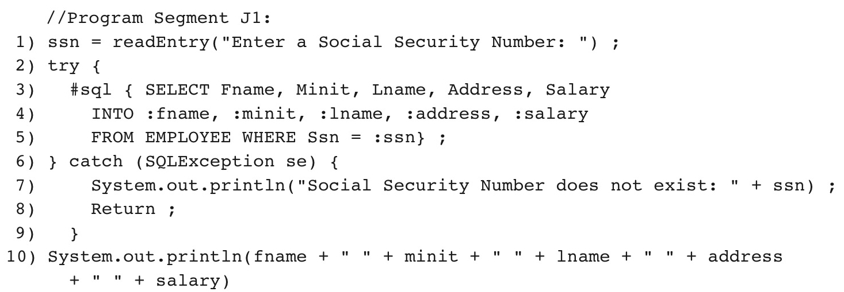
Figure 10.7 Program Segment J1, a Java Program Segment with S Q L J

Slide 25
Retrieving Multiple Tuples in S Q L J Using Iterators
Iterator
Object associated with a collection (set or multiset) of records in a query result
Named iterator
Associated with a query result by listing attribute names and types in query result
Positional iterator
Lists only attribute types in query result

Slide 26
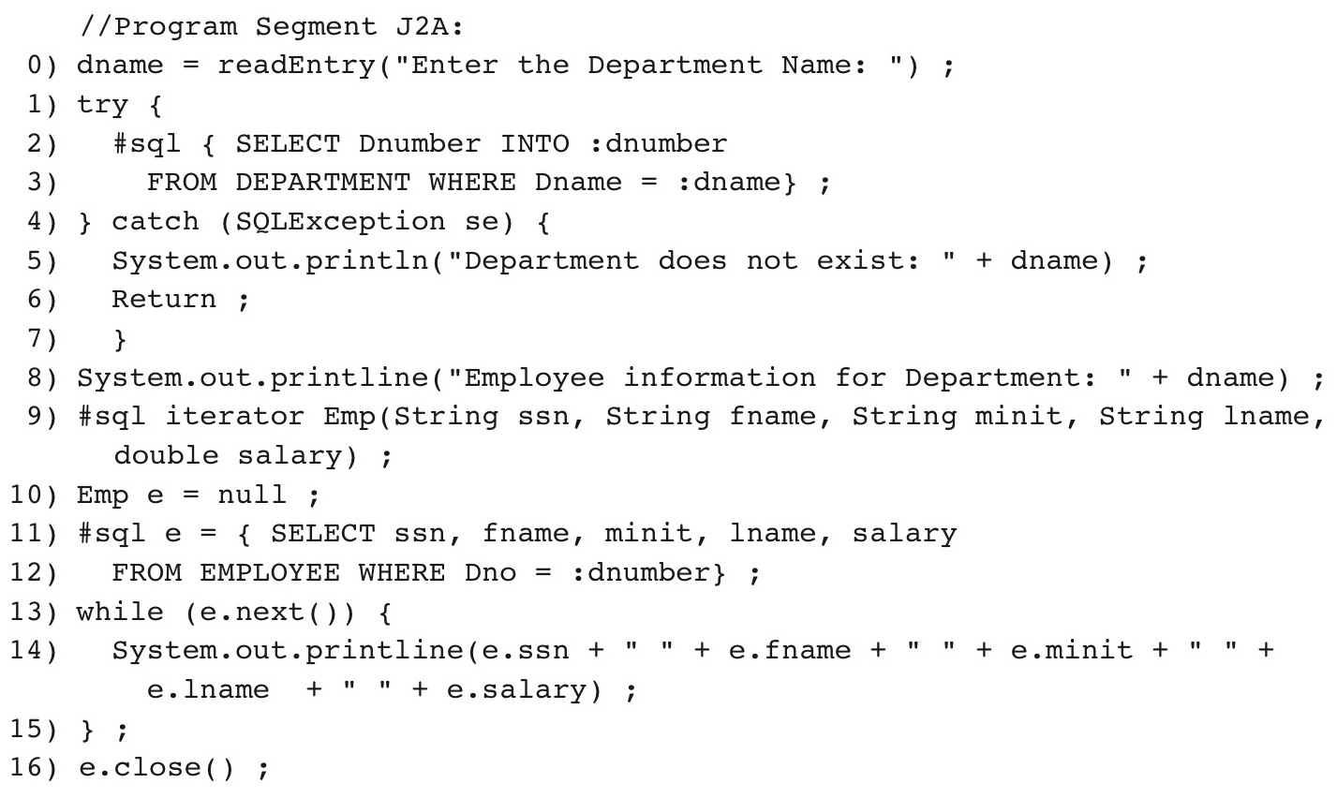
Figure 10.8 Program Segment J2A, a Java Program Segment That Uses a Named Iterator to Print Employee Information in a Particular Department

Slide 27
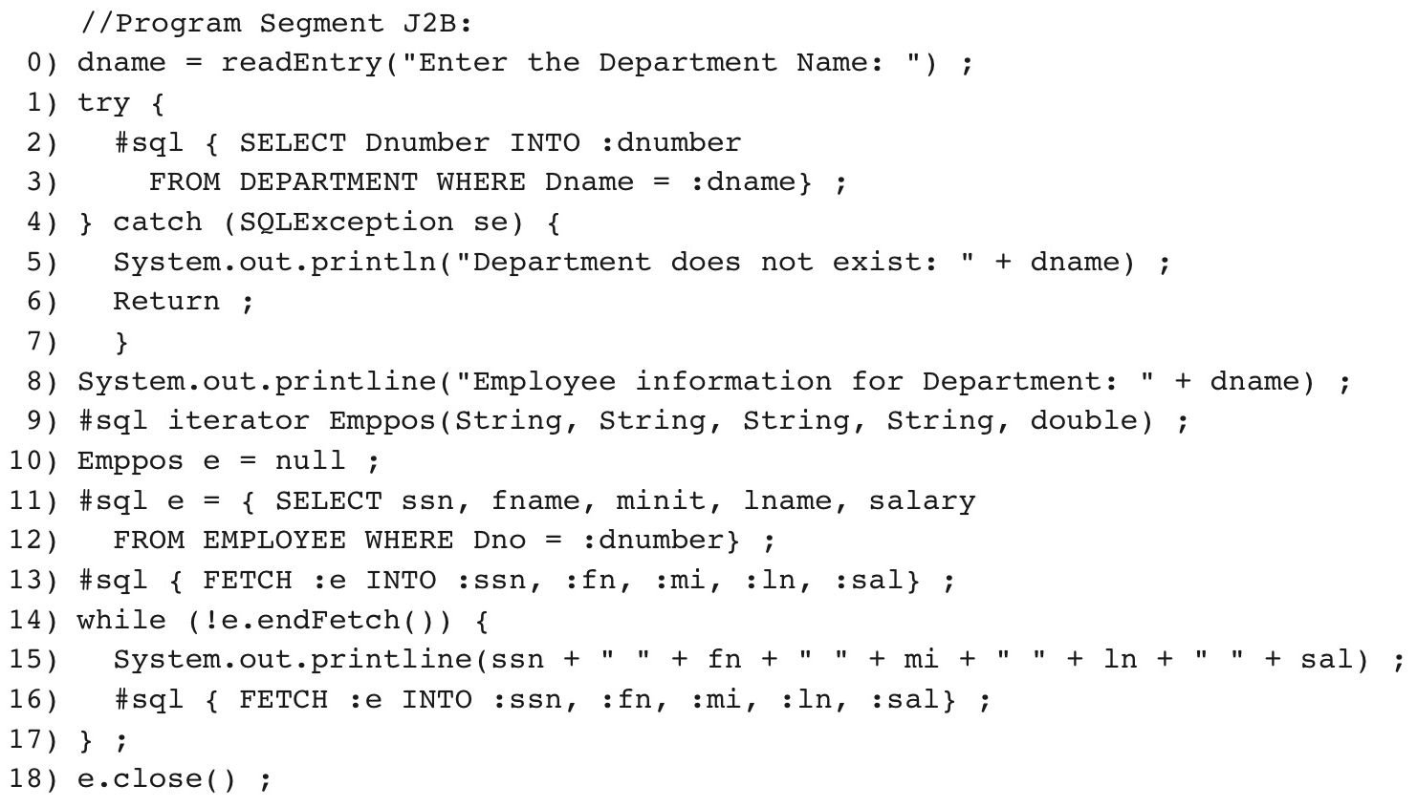
Figure 10.9 Program Segment J2B, a Java Program Segment That Uses a Positional Iterator to Print Employee Information in a Particular Department

Slide 28
Database Programming with Function Calls: S Q L/C L I & J D B C
Use of function calls
Dynamic approach for database programming
Library of functions
Also known as application programming interface (A P I)
Used to access database
S Q L Call Level Interface (S Q L/C L I)
Part of S Q L standard

Slide 29
S Q L/C L I: Using C as the Host Language (1 of 2)
Environment record
Track one or more database connections
Set environment information
Connection record
Keeps track of information needed for a particular database connection
Statement record
Keeps track of the information needed for one S Q L statement

Slide 30
S Q L/C L I: Using C as the Host Language (2 of 2)
Description record
Keeps track of information about tuples or parameters
Handle to the record
C pointer variable makes record accessible to program

Slide 31
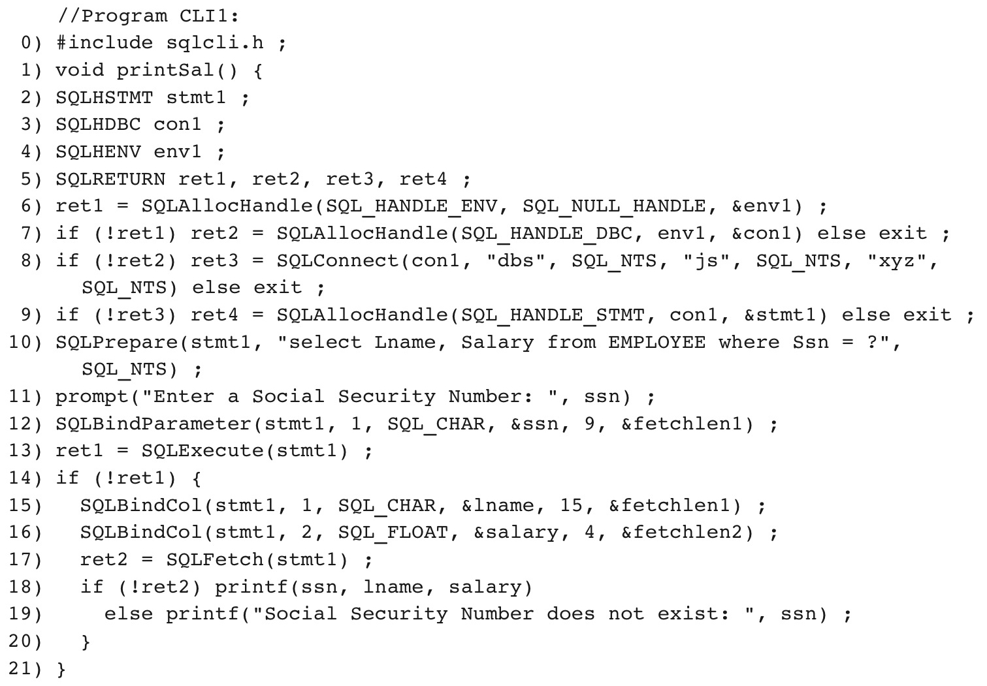
Figure 10.10 Program Segment C L I 1, a C Program Segment with S Q L/C L I

Slide 32
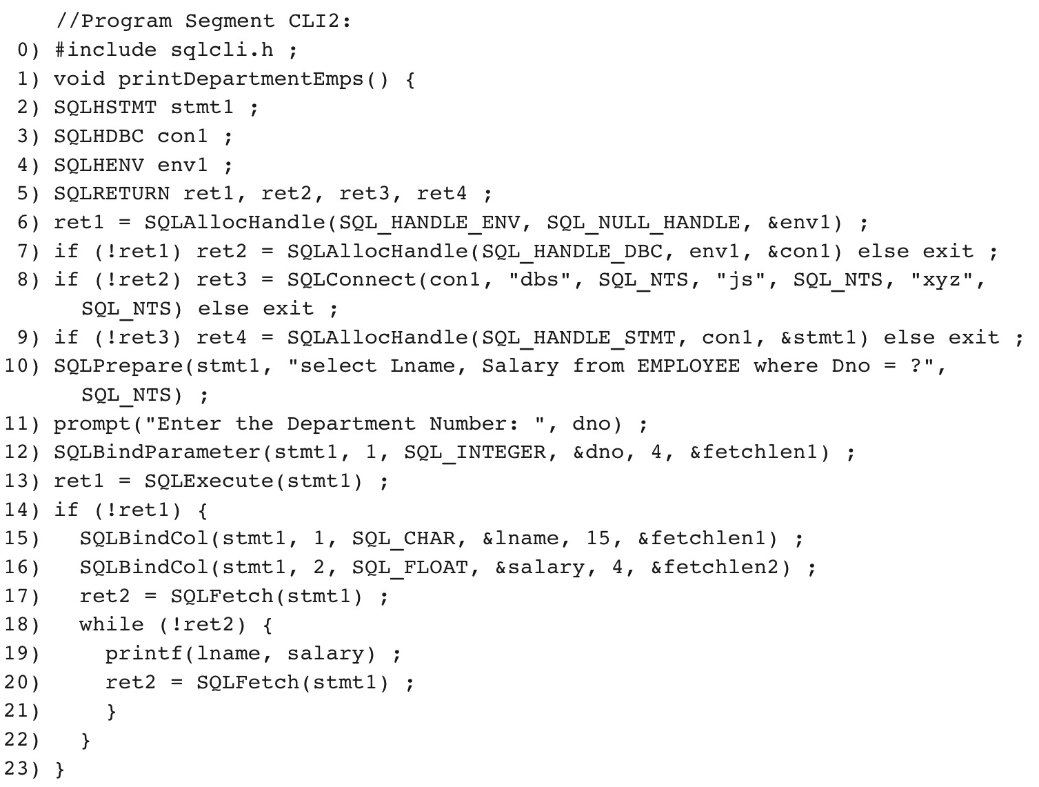
Figure 10.11 Program Segment C L I 2, a C Program Segment That Uses S Q L/C L I for a Query with a Collection of Tuples in Its Result

Slide 33
J D B C: S Q L Function Calls for Java Programming (1 of 2)
J D B C
Java function libraries
Single Java program can connect to several different databases
Called data sources accessed by the Java program
,
Load a J D B C driver explicitly

Slide 34
J D B C: S Q L Function Calls for Java Programming (2 of 2)
Connection object
Statement object has two subclasses:
PreparedStatement and CallableStatement
Question mark (?) symbol
Represents a statement parameter
Determined at runtime
ResultSet object
Holds results of query

Slide 35
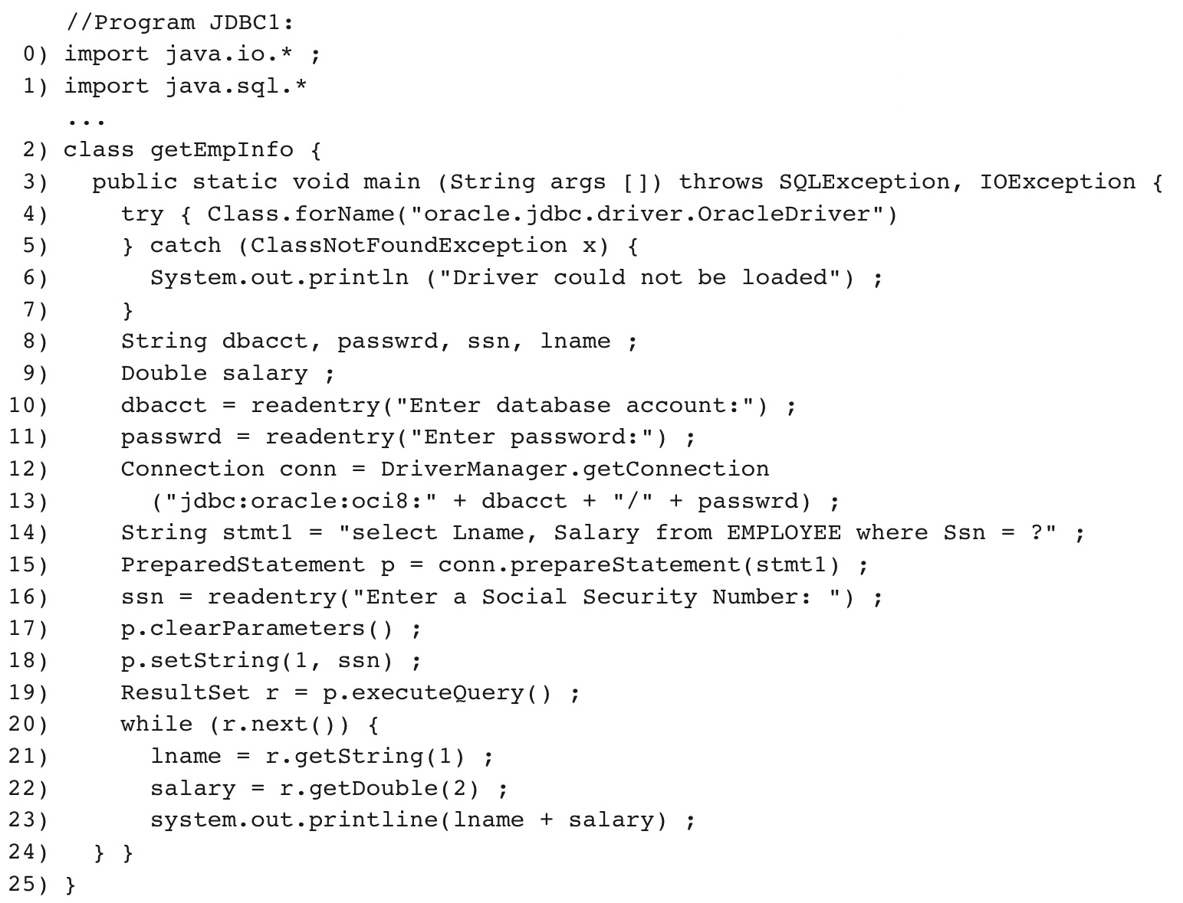
Figure 10.12 Program Segment J D B C 1, a Java Program Segment with J D B C

Slide 36
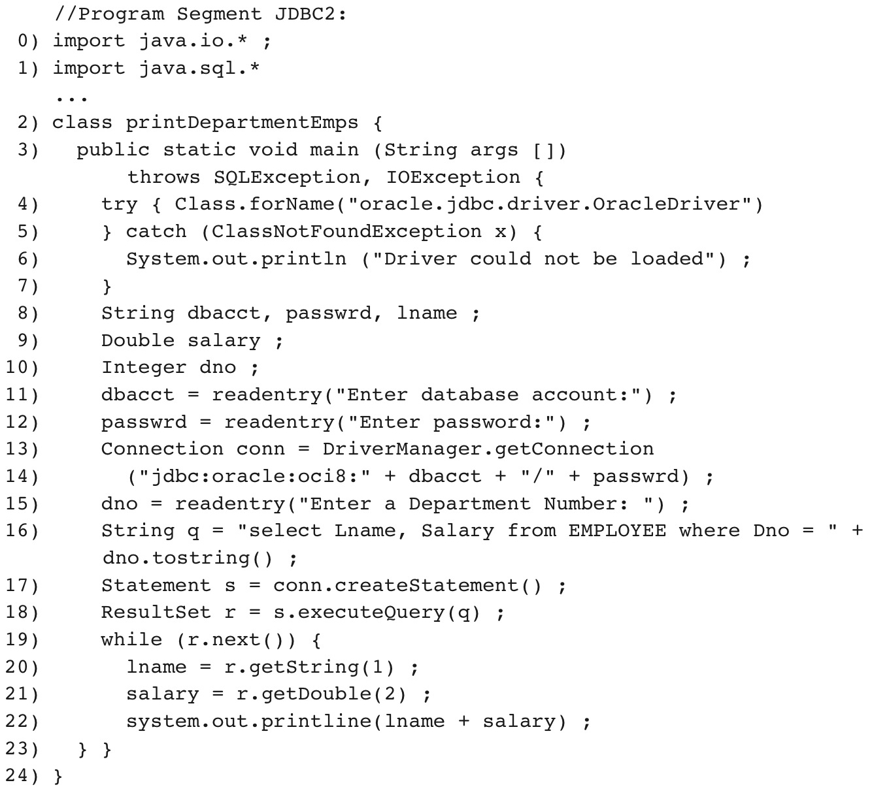
Figure 10.13 Program Segment J D B C 2, a Java Program Segment That Uses J D B C for a Query with a Collection of Tuples in Its Result

Slide 37
Database Stored Procedures and S Q L/P S M
Stored procedures
Program modules stored by the D B M S at the database server
Can be functions or procedures
S Q L/P S M (S Q L/Persistent Stored Modules)
Extensions to S Q L
Include general-purpose programming constructs in S Q L

Slide 38
Database Stored Procedures and Functions (1 of 3)
Persistent stored modules
Stored persistently by the D B M S
Useful:
When database program is needed by several applications
To reduce data transfer and communication cost between client and server in certain situations
To enhance modeling power provided by views

Slide 39
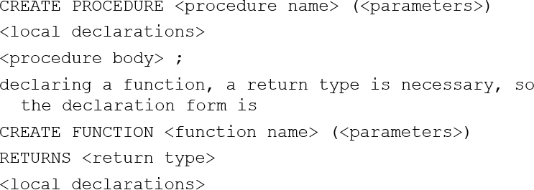
Database Stored Procedures and Functions (2 of 3)
Declaring stored procedures:

Slide 40
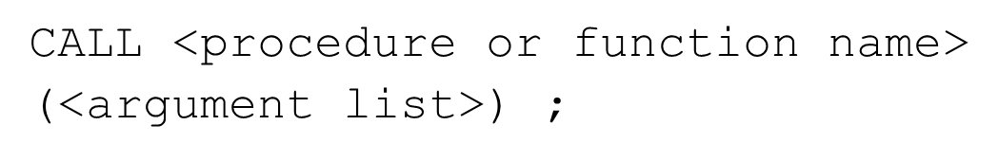
Database Stored Procedures and Functions (3 of 3)
Each parameter has parameter type
Parameter type: one of the S Q L data types
Parameter mode: IN, OUT, or INOUT
Calling a stored procedure:

Slide 41
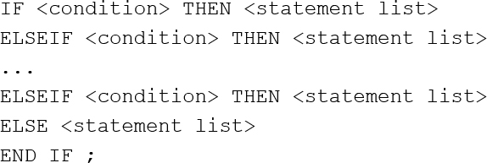
S Q L/P S M: Extending S Q L for Specifying Persistent Stored Modules (1 of 2)
Conditional branching statement:

Slide 42
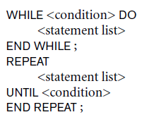
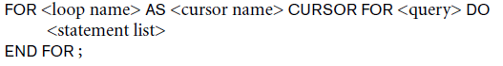
S Q L/P S M: Extending S Q L for Specifying Persistent Stored Modules (2 of 2)
Constructs for looping

Slide 43
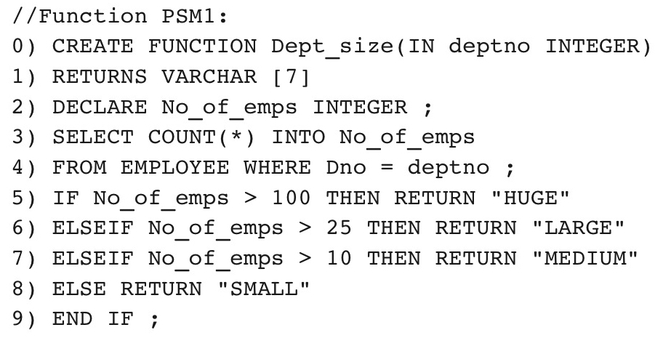
Figure 10.14 Declaring a function in S Q L/P S M

Slide 44
Comparing the Three Approaches (1 of 2)
Embedded S Q L Approach
Query text checked for syntax errors and validated against database schema at compile time
For complex applications where queries have to be generated at runtime
Function call approach more suitable

Slide 45
Comparing the Three Approaches (2 of 2)
Library of Function Calls Approach
More flexibility
More complex programming
No checking of syntax done at compile time
Database Programming Language Approach
Does not suffer from the impedance mismatch problem
Programmers must learn a new language

Slide 46
Summary
Techniques for database programming
Embedded S Q L
S Q L J
Function call libraries
S Q L/C L I standard
J D B C class library
Stored procedures
S Q L/P S M

Slide 47

Copyright

